Slide 1
Insights From Data
Lecture 4
Data Visualization and exploration

Slide 2
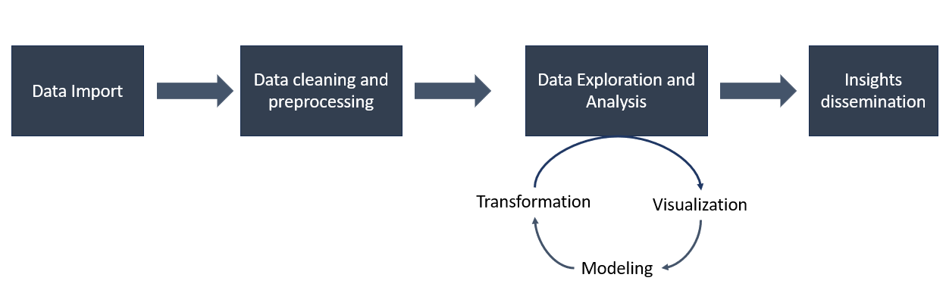
Insights from data

Slide 3
Insights from data
Data cleaning and preparation (Outlier detection)
Data Visualization
Descriptive analysis

Slide 4
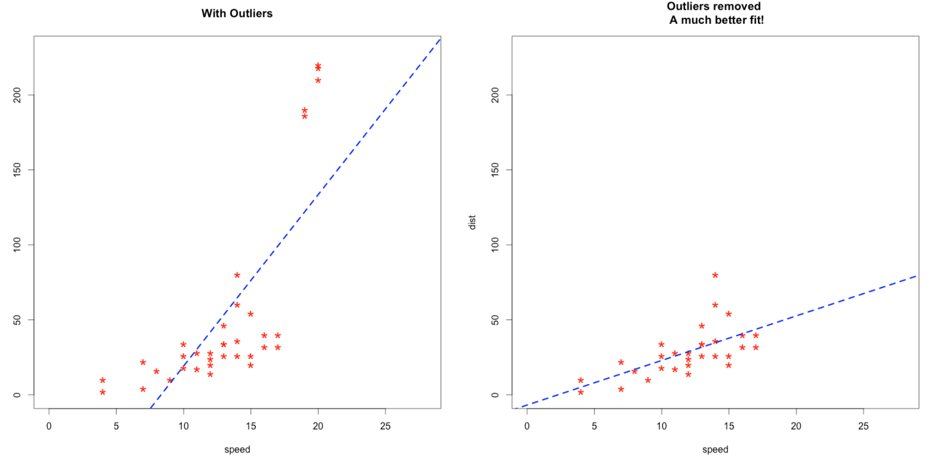
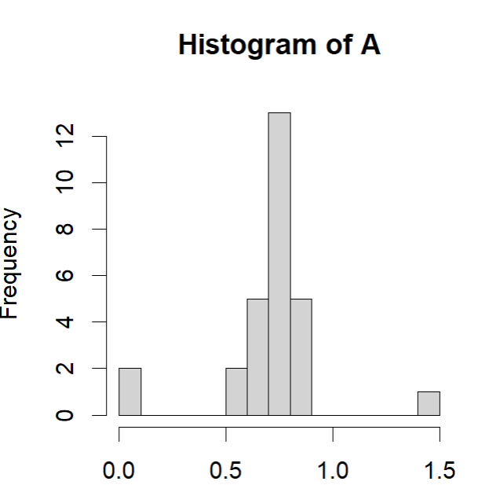
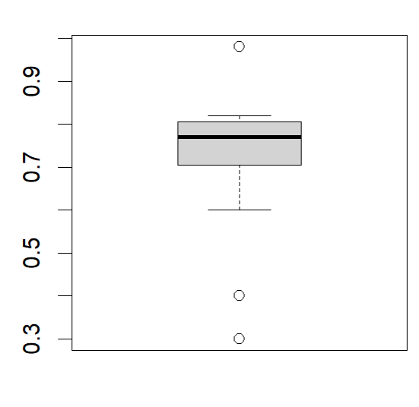
Outliers
Outliers are values that significantly differ from the majority of the other data points in a set
Outlier detection with visualization techniques
How to deal with outliers
Removing outliers
Replacing outliers with NA and treating them
as missing values in the data analyses proses.

Slide 5
Data Visualization
Fundamental graphical methods of data analysis
Scatterplot: displays the relation between two numerical variables
Line plots: They are often used to study chronological trends and patterns.
Bar plots: Visualize categorical distributions
Histogram: Visualize numerical distributions
Boxplots
Heatmaps

Slide 6
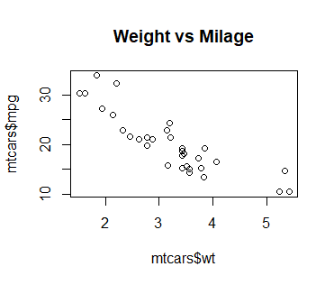
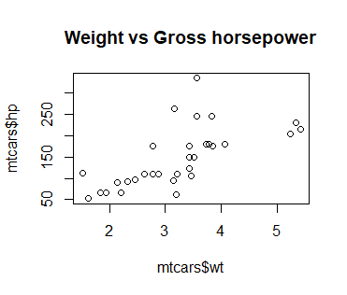
Scatterplot
A scatter plot displays the relation between two numerical variables
Plot “Weight vs Milage” shows a negative association between the variables
Plot “Weight vs Gross horsepower” shows a positive association between the variables
data("mtcars")
plot(mtcars$wt, mtcars$mpg,main = "Weight vs Milage")
plot(mtcars$wt, mtcars$hp,,main = "Weight vs Gross horsepower")

Slide 7
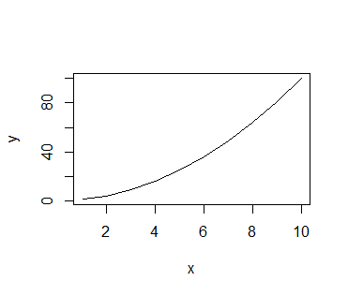
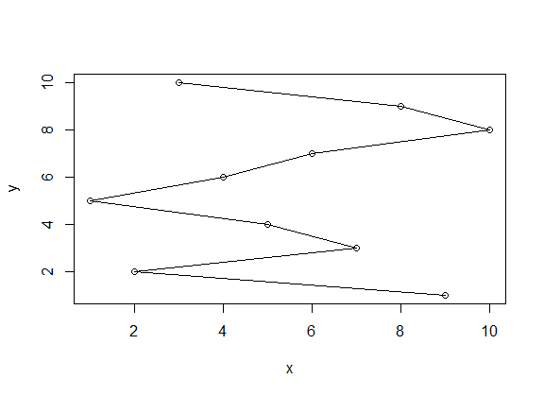
Line plots
The most common visualizations.
They are often used to study chronological trends and patterns.
x= 1:10
y= x^2
plot(x, y, type = "l")
x= sample(10)
y= 1:10
plot(x, y, type = "o")

Slide 8
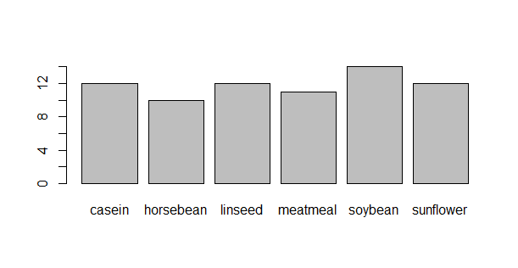
Bar plots
Visualizing categorical distributions
data("chickwts")
barplot(table(chickwts$feed))

Slide 9
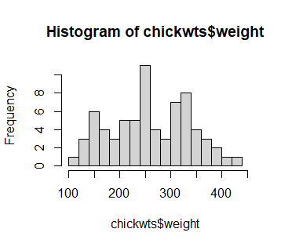
Histogram
hist(chickwts$weight, breaks = 20)
Organizes a group of data points into user-specified ranges
Visualizing numerical distributions
Key aspects of histograms:
Distribution Shape: Indicates whether the data follows a normal distribution, is skewed (right or left), or has multiple peaks (bimodal).
Central Tendency: The height of the bars shows where most values (modes) are concentrated.
Spread: The width of the histogram reflects the variability in the data; wider indicates more variability.
Outliers: Isolated bars may indicate unusual data points.
Frequency: Each bar’s height represents how many data points fall within that range.

Slide 10
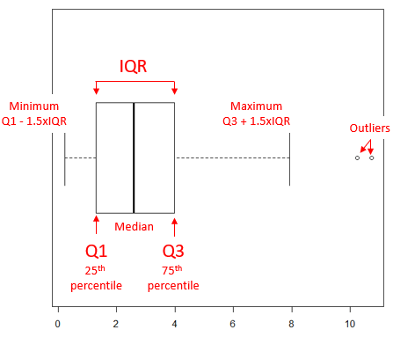
Box plot
Visualize the distribution of a numerical variable and summarize key statistics within a dataset.
A boxplot displays:
Median: The line in the center of the box shows the median value.
Interquartile Range (IQR): The box spans the range between the 1st (Q1) and 3rd (Q3) quartiles, covering the middle 50% of values.
Whiskers: Lines extending from the box indicate the range of values within 1.5 times the IQR.
Outliers: Points beyond the whiskers represent outliers.
Image from:
https://biostatistics.letgen.org/mikes-biostatistics-book/how-to-report-statistics/box-plot/

Slide 11
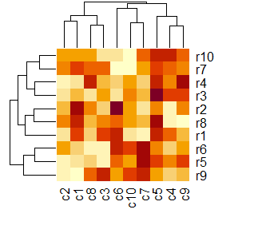
Heatmap
It represents data graphically, using colors to depict individual values within a matrix
mat=matrix(runif(100, min=0, max=100), 10,10)
rownames(mat)= c("r1","r2","r3","r4","r5","r6","r7", "r8","r9","r10")
colnames(mat)= c("c1","c2","c3","c4","c5","c6","c7", "c8","c9","c10")
heatmap(mat)

Slide 12
ggplot2: Advanced and Flexible Data Visualization in R
Creates customizable and high-quality data visualizations in R.
Easy generation of various visualizations like scatter plots, bar plots, and more.
Allows the addition of data points, lines, and labels for enhanced visualization.
Widely used for data analysis and visualization in data science and statistics.
Data stored in dataframe
Tutorial: http://r-statistics.co/Complete-Ggplot2-Tutorial-Part1-With-R-Code.html

Slide 13
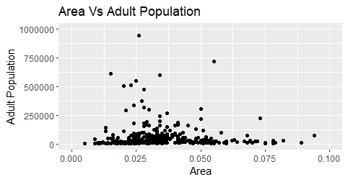
Package ggplot2, Scatterplot
Explore if there’s a pattern or relationship between the size of a county and its adult population
library(ggplot2)
data("midwest")
g= ggplot(midwest, aes(x=area, y=popadults)) + geom_point()
#Adjusting the X and Y axis limits
g= g + xlim(c(0, 0.1)) + ylim(c(0, 1000000))
#Changing the Title and Axis Labels
g= g + labs(title="Area Vs Adult Population", y="Adult Population", x="Area")

Slide 14
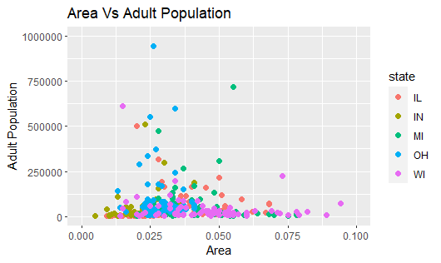
Scatterplot in ggplot2 Changing the Color To Reflect Categories in Another Column
library(ggplot2)
data("midwest")
g= ggplot(midwest, aes(x=area, y=popadults)) + geom_point()+
geom_point(aes(col=state), size=2)
#Adjusting the X and Y axis limits
g= g + xlim(c(0, 0.1)) + ylim(c(0, 1000000))
#Changing the Title and Axis Labels
g= g + labs(title="Area Vs Adult Population", y="Adult Population", x="Area")

Slide 15
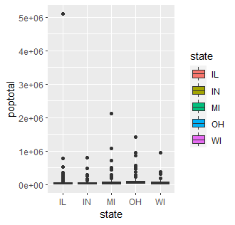
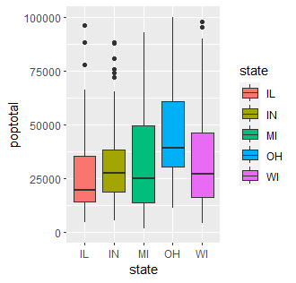
Ggplot2, boxplot
Visualizing the distribution of total population (poptotal) across different states in the midwest dataset.
g= ggplot(midwest, aes(x=state, y=poptotal, fill= state)) +
geom_boxplot()
g= g+ ylim(c(0, 100000))
Reference:
https://www.geeksforgeeks.org/box-plot-in-r-using-ggplot2/

Slide 16

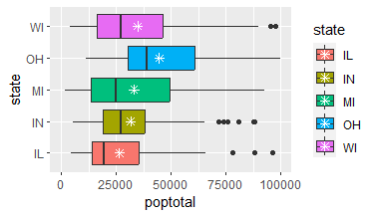
GGplot2, boxplot
g= ggplot(midwest, aes(x=state, y=poptotal, fill= state)) +
geom_boxplot()+ ylim(c(0, 100000))+
stat_summary(fun = "mean", geom = "point", shape = 8, size = 2, color ="white")
g= g+ coord_flip()

Slide 17
Class exercise
Load the “chickwts” dataset into R
Use ggplot2 to plot the weight for different feed supplements using boxplot.
Which type of feed supplements seems to be more effective for chickens to growth?

Slide 18
Descriptive analysis
Descriptive Statistics: Provide summaries of data through numerical measures, graphs, or tables, offering insights into data patterns and characteristics.
Numerical Calculations
Measures of Central Tendency: Mean, Median, Mode
Measures of Spread: Variance, Standard Deviation, Range
Visualization Techniques
Graphical representations such as bar charts, histograms, and boxplots help visualize data distribution, central tendency, and variability.

Slide 19
Type of average
Mean: Also known as the average, it is calculated by adding all values and dividing by the total count. (mean())
Median: The middle value of a data set, found by arranging data from lowest to highest and selecting the value at the center.(median)
Mode: The value that appears most frequently in a data set.
R - Mean, Median and Mode: https://www.tutorialspoint.com/r/r_mean_median_mode.htm

Slide 20
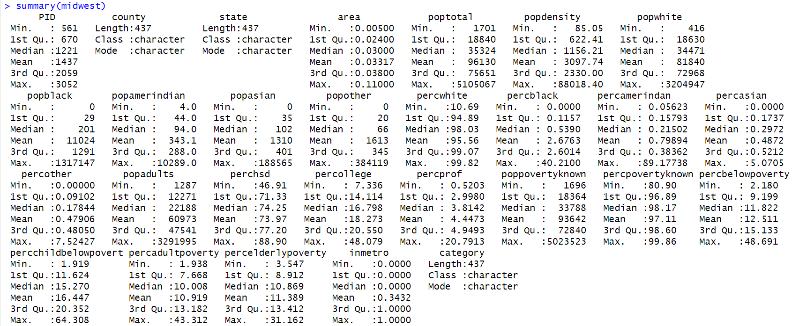
Descriptive analysis

Slide 21
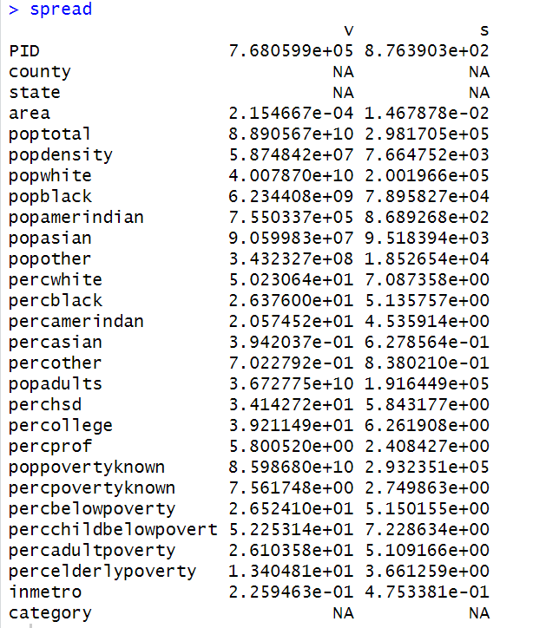
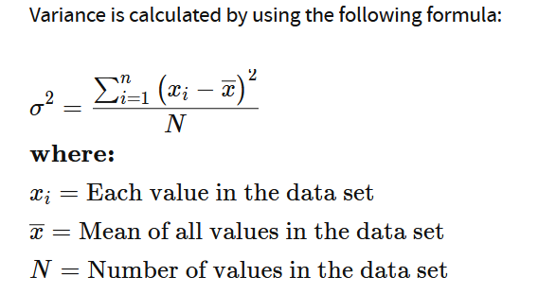
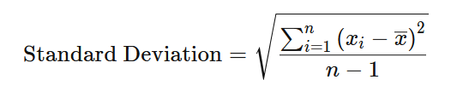
Descriptive analysis: Type of spread
variance= apply(midwest, 2, var)
std= apply(midwest, 2, sd)
spread= cbind(variance, std)
print(spread)
Variance: The average of the squared differences from the mean, reflecting the dispersion of data points.
Standard Deviation: The square root of variance

Slide 22
Summary
Visualization techniques
Descriptive analysis: type of average and type of spread

Slide 23
NEXT
Data exploration and analysis:
Data transformation
Clustering for pattern discovery

